Slide 1
C372 Payment Technologies
L01 Checking your installations and setup

Slide 2
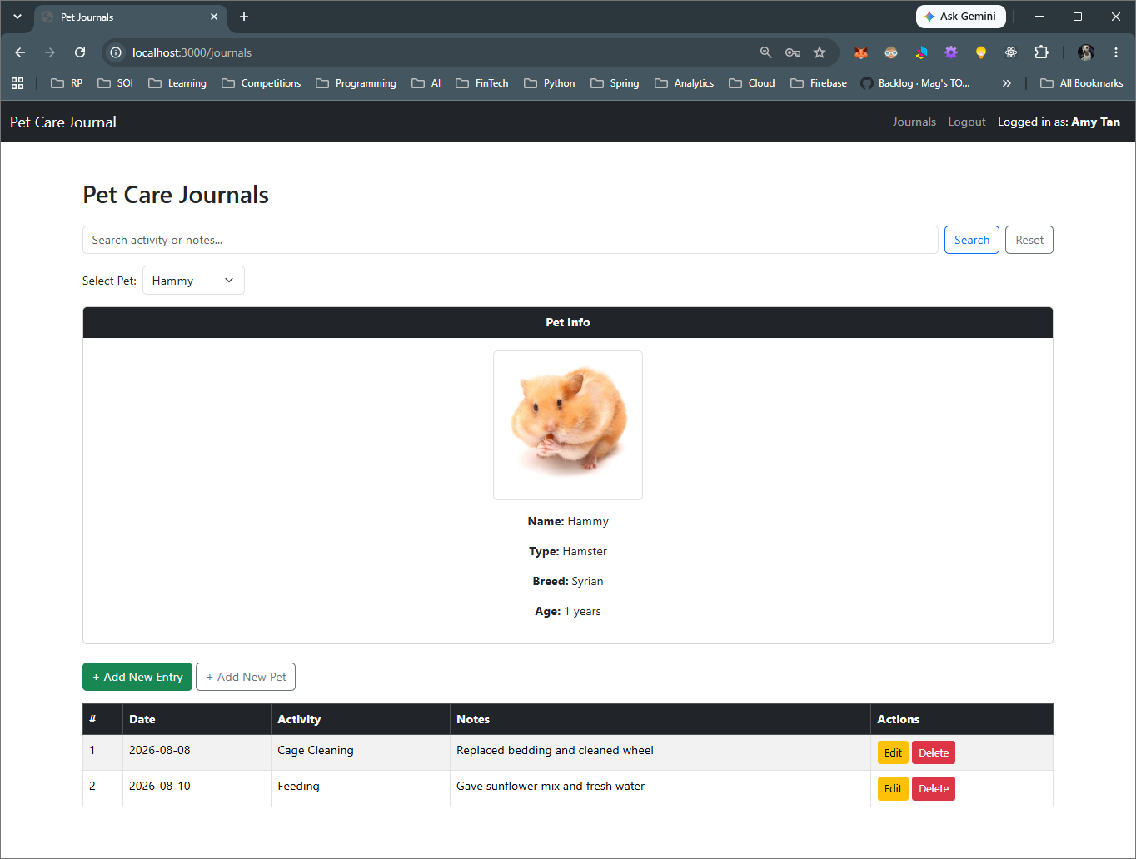
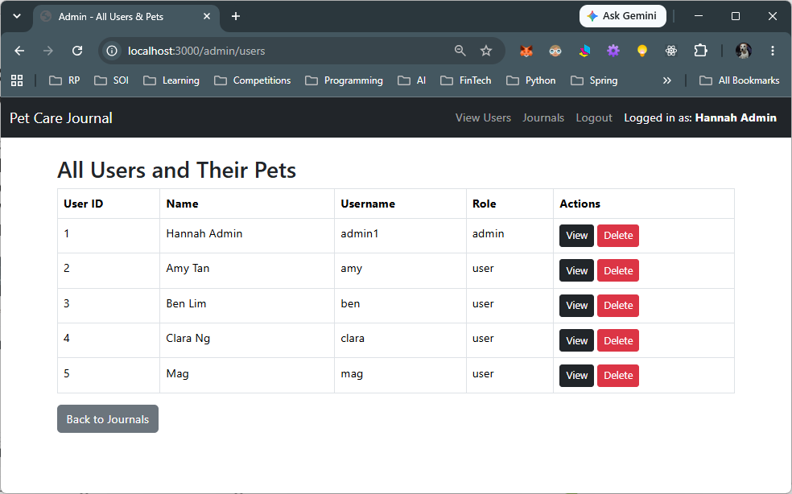
Web Application Development Review
In C237 Software Application Development, you created a web application that applied concepts such as:
  CRUD
  Validation
  Roles – Authentication and Authorisation

Slide 3
Web Application Development Review
In this module, we will be building on the skills and knowledge from C237 Software Application Development and infusing payment technologies into the application.
The tools we will use are similar to what you have used in C237
  VSCode (https://code.visualstudio.com/download)
  NodeJS (https://nodejs.org/en)
  MySQL (https://dev.mysql.com/downloads/mysql/)
  MySQL Workbench(Recommended) or PhpMyAdmin (https://dev.mysql.com/downloads/workbench/)
  Git (https://git-scm.com/downloads)
  GitHub extension for VSCode
  You may also refer to the resources from C206, and C207 in the Resources folder provided to you.

Slide 4
Web Application Development Review
To check that you have everything you need for this module, we will set up a new project.
Do create a new working folder for this module. (Don’t mix up your code from C237)

Slide 5
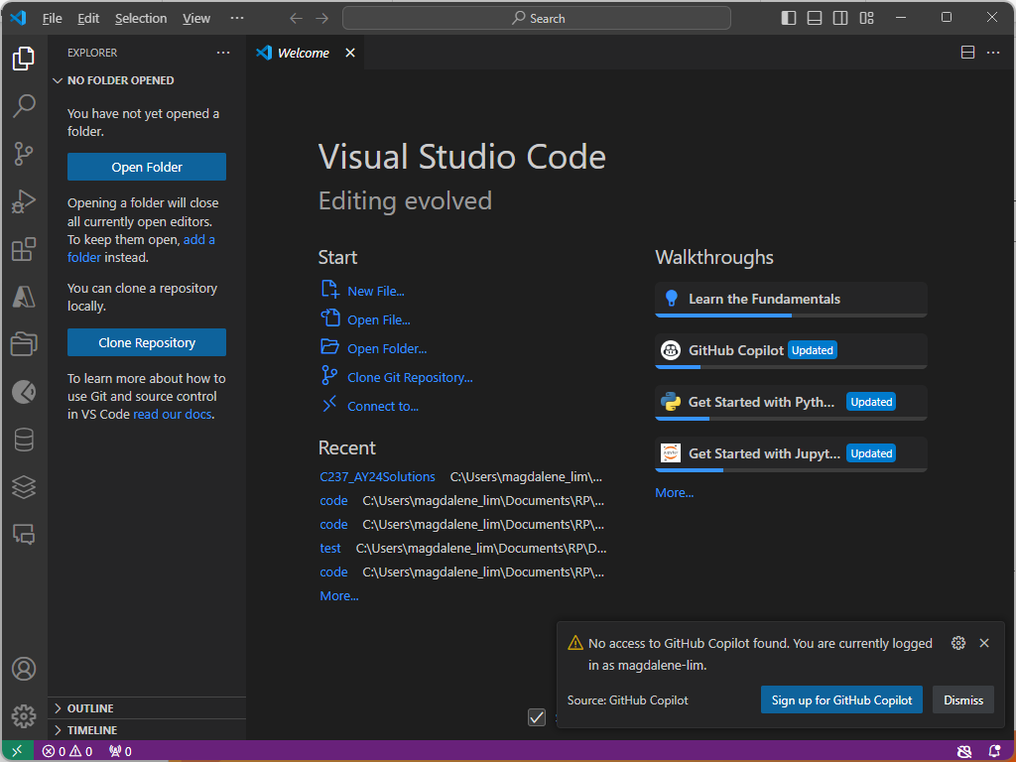

Setting up a new project
Start a new VSCode Window. It should look similar to the screen capture here.
Click on to open the VSCode explorer panel
Click Open Folder to browser to the location where you wish to store your code. (Usually in the module folder itself)

Slide 6
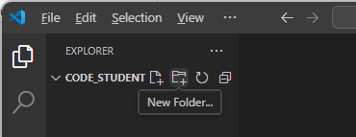
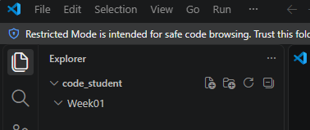
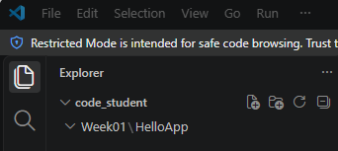
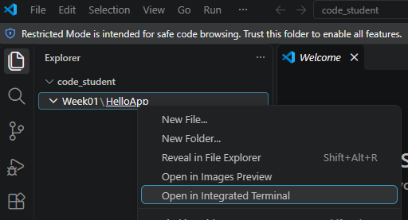
Setting up a new project
You should see an empty folder
Click on the New Folder icon to create a new folder named Week01
Right-click on Week01 folder to create a new folder within the Week01 folder, named HelloApp
Right-click on the HelloApp folder and select Open in Integrated Terminal

Slide 7
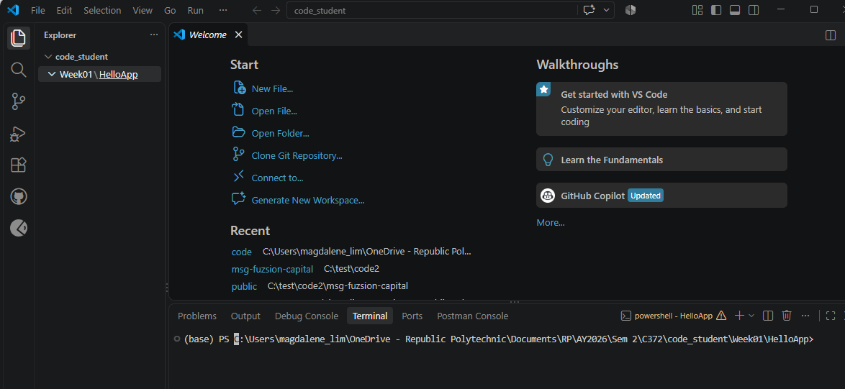
Setting up a new project
You should see the console appearing below.
Check that the console is in the HelloApp folder

Slide 8
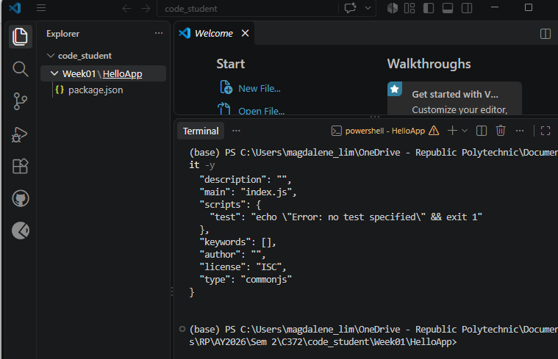
Setting up a new project
To initialize the HelloApp folder as a NodeJS project, enter the command in the console.
npm init –y
You should see the changes in VSCode project structure and console output

Slide 9
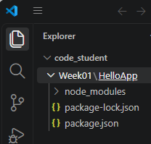
Setting up a new project
Recall in C237, we installed several packages.
To test our setup, we will only install the express package
To install, type the command in the console:
  npm install express
Again, observe the changes to the project structure

Slide 10
Setting up a new project
Right-click on HelloApp and select New File
Name the new file app.js
Copy the code below and paste into app.js
const express = require('express');
const app = express();
app.get('/', (req, res) => {
res.send("Hello World!")
})
const PORT = process.env.PORT || 3000;
app.listen(PORT, () => console.log(`Server running on port ${PORT}`));
*Note: You may need to replace the quotes in the code above when u paste to VSCode due to formatting issues

Slide 11
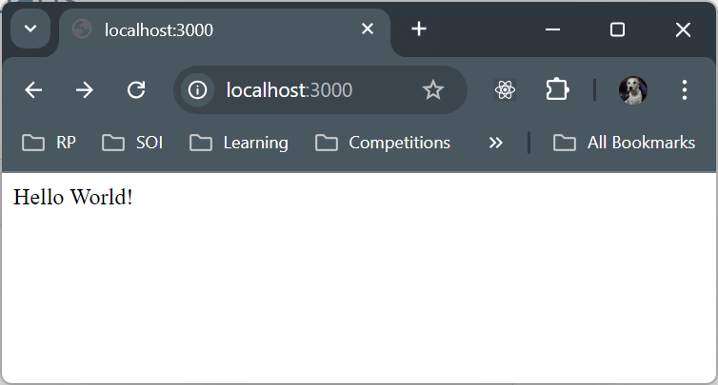
Setting up a new project
Run your application by entering the command in the console:
node app.js
Open a web browser and enter the URL http://localhost:3000/ in your web browser
You should see a greeting similar to the screenshot here:

Slide 12

Exercise 1
Paste a screenshot your VS Code HelloApp project structure in your worksheet.
Modify app.js so that the greeting changes to “Hello RP!”
Paste a screenshot of your web browser displaying the new greeting from HelloApp in your worksheet.

Slide 13
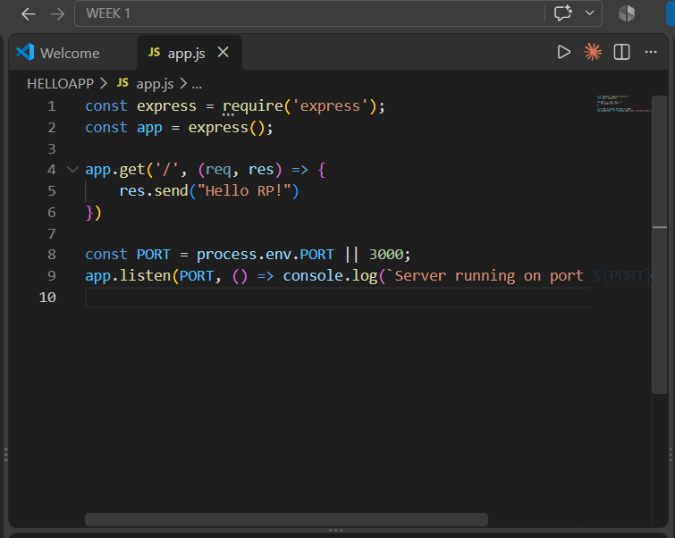
Part A

Slide 14
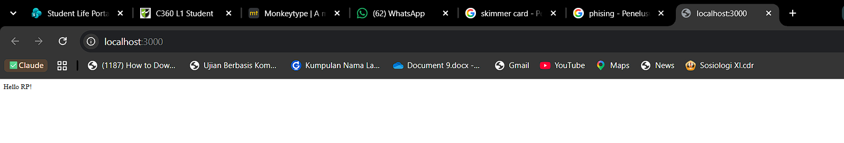
Part B&C

Slide 15
Setting up a new project
That’s it, to test that the setup on your laptop can run a simple NodeJS app.
Now let’s try it with an app that should be very familiar to you, the student list app from C237!

Slide 16
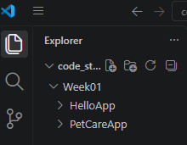
Setting up PetCareApp
In the Resources folder provided to you, you should find a folder named PetCareApp
Right click on PetCareApp folder and copy this folder. (Ctrl-C)
Go to Week01 folder in VSCode and paste PetCareApp into Week01 folder. (Ctrl-V)
Check that PetCareApp is within Week01 folder and on the same level as HelloApp(NOT inside HelloApp). It should look similar to the screenshot here.

Slide 17
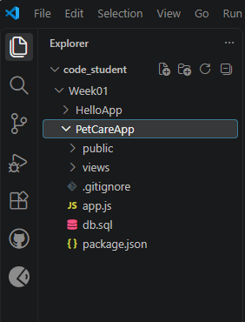
Setting up PetCareApp
Expanding the PetCareApp folder, you should see project structure similar to the screenshot here.
Notice that node_modules is missing

Slide 18
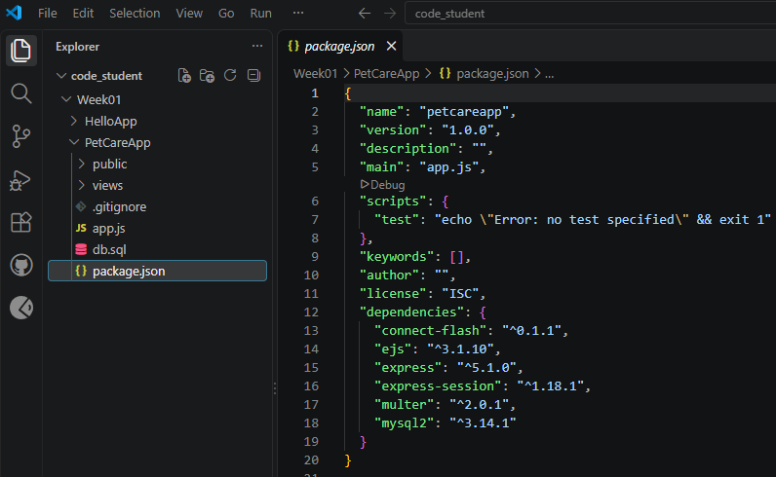
Setting up PetCareApp
Click on package.json
Observe that the dependencies are already listed inside
As a best practice, when we push to GitHub or similar, we should not push the node_modules folder as it can become rather large and take up precious repository space.
Instead, we make use of what is in package.json to know what dependencies are needed.
The next slide shows us how to install the relevant modules easily.

Slide 19
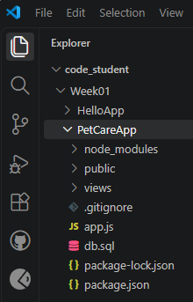
Setting up PetCareApp
Right-click on the PetCareApp folder and select Open in Integrated Terminal
In the console, type
npm install
Observe the changes to the project structure
*npm install installs all the dependencies listed in package.json so you do not need to install each dependency one by one as what you did in C237.

Slide 20
Setting up PetCareApp
In the PetCareApp folder, you will see db.sql which contains the schema to setup the database for this application.
If you still have your existing database named petcare and it follows the same structure, you can continue to use the database.
Otherwise, you will need to set up your database.

Slide 21
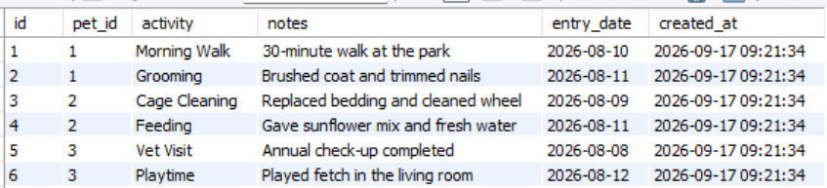
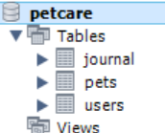
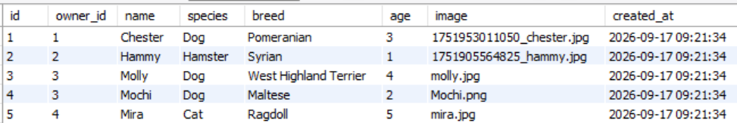
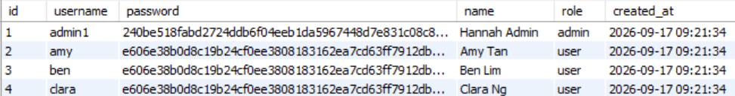
Setting up petcare DB
In C237, the database name for this app was petcare
Connect to MySQL Workbench to check that you still have the database and data
Sample screens of how they should look like is shown below

Slide 22
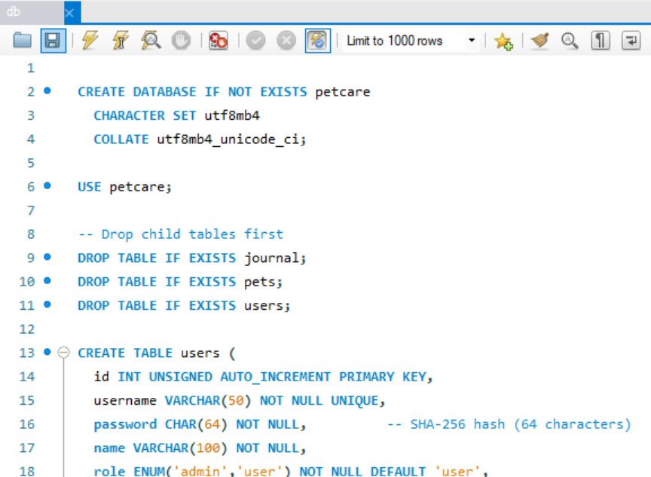
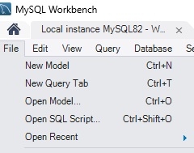
Setting up petcare DB
If you do not have the database setup or the data, you may use db.sql that has been provided to you in the PetCareApp folder
In MySQL Workbench, go to File > Open SQL Script and browse to where db.sql is saved.
Click on to execute the script.

Slide 23
Setting up petcare DB
Check that you can see the database and data similar to below

Slide 24
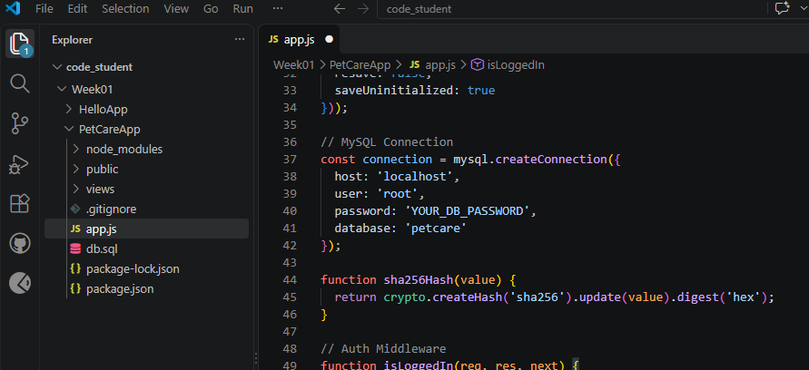
Running PetCareApp
In app.js update the database details for user, password* and database name
*If you have forgotten your database password, check your previous C237 app.js to see what your database password was.

Slide 25
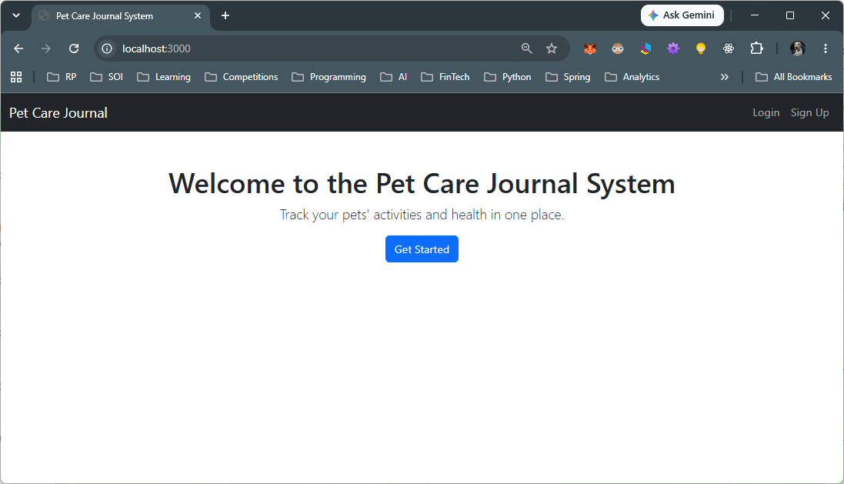
Running PetCareApp
Run your application by entering the command in the console:
node app.js
If everything is installed correctly, you should see the message in the console:
Open a web browser and enter the URL as shown in the screen capture

Slide 26
Running PetCareApp
You have successfully set up and run your PetCareApp from C237!
Login as a user and admin to test that all the features to are working.

Slide 27
Exercise 2
Paste a screenshot of your VS Code PetCareApp project structure in your worksheet.
Paste a screenshot of your web browser displaying the list of users from PetCareApp in your worksheet.

Slide 28

NodeJS Project Folder Structure
Project folder
Assets such as images, javascript, css should be stored here
Dependencies(external libraries or packages) will be installed here
EJS files that contain HTML and embedded JavaScript in this folder
Entry point for the project to run, also contains business logic*
Files to be ignored when pushing to git
Contains meta data about the project(e.g. project name, description), dependencies required by the project, etc.
Automatically generated when you run npm install for the first time. Locks the version of the packages

Slide 29

GitHub
Do sign up for the GitHub Education account using your school email if you have not done so.
Use your school email address if possible - it speeds up verification.
If you see a “PRO” label on your profile, that should indicate that you have student benefits activated.
GitHub Student Developer Pack - GitHub Education

Slide 30
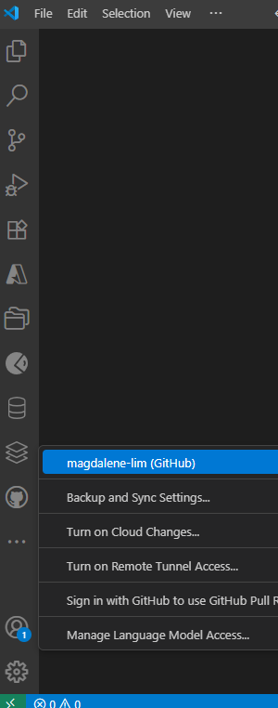
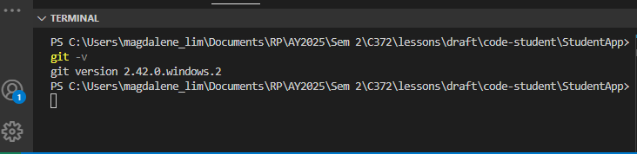
Git, GitHub
Check that you have the GitHub extension installed and you are signed in
To check if you have git installed, in the terminal, enter: git -v

Slide 31
.gitignore
A .gitignore file is a plain text file that instructs Git to ignore specified files and directories in a repository. By listing files that shouldn't be tracked, it prevents you from accidentally committing temporary files, build artifacts, or other unneeded data.
It contains a list of patterns, typically placed in the root directory, that match files and folders to be excluded, such as log files, temporary files, or build artifacts.
Once a file/directory is in .gitignore, Git will not track changes to it, though it won't ignore files that have already been committed.

Slide 32
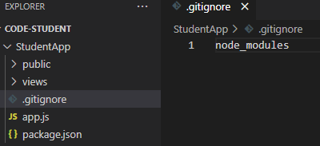
.gitignore
Create the file: Place a text file named .gitignore in the root directory of your Git repository.
Add patterns: Open the file in a text editor and add a new pattern on each line. These patterns can be specific file names, directory names, or wildcard expressions.
Commit the file: After adding the patterns, commit the .gitignore file to your repository. This ensures that the ignore rules are version-controlled and shared with anyone who clones the project.
By adding node_modules in .gitignore, node_modules will not be tracked or uploaded into GitHub

Slide 33
Create the Local Git Repository
You can also refer to the video demo: C372_VSCode_GitHub_Initialise_Publish_Guide.mp4
In VSCode, select the folder that you wish to push to GitHub. (In this module and the demo video, we suggest that you push the whole folder that stores your C372 code for all the weeks.)
Click the Source Control icon on the far-left vertical sidebar (it looks like a three-pronged branching tree).
Initialize Git: Click the blue Initialize Repository button in the sidebar. Your files will instantly appear under a list called Changes.
Stage your files: Hover your mouse over the word Changes and click the + (plus sign) icon to stage all files for your first save.
Commit your changes: Type a message (like Initial commit) into the text box at the top of the sidebar, then click the blue Commit button.

Slide 34
Publish Your Repository to GitHub
You can also refer to the video demo: C372_VSCode_GitHub_Initialise_Publish_Guide.mp4
Trigger the publish option: In that same Source Control sidebar, click the blue Publish Branch (or Publish to GitHub) button.
Authorize GitHub (First time only):
  Click Allow on the pop-up asking to let VS Code sign into GitHub.
  Your web browser will open. Log into GitHub if prompted, click Authorize VisualStudioCode, and then confirm to return to VS Code.
Choose privacy level: A dropdown menu will appear at the top center of VS Code. Select either:
  Publish to GitHub private repository (Hidden from the public)
  Publish to GitHub public repository (Visible to anyone. Choose this option as this will be part of your portfolio as a student)
Name and upload: Confirm or type your repository name and press Enter.
VS Code will automatically link your local folder to GitHub and push your code. When it finishes, a pop-up in the bottom-right corner will give you an Open on GitHub button so you can view your live repository online!

Slide 35

GitHub Repositories
You are encouraged to upload your code to GitHub to build your portfolio as a DFT student.
Some tasks in this module will award additional credits when you check in your code to GitHub.
Do review C206 Version Control guides in the Resources folder provided to you

